Slide 1
Strategies for Disseminating
Best Practices in Long COVID Rehabilitation
Lisa A. Juckett, PhD, OTR/L, CHT
Didactic Core
Learning Health Systems Rehabilitation Research Network (LeaRRn)
lisa.juckett@osumc.edu
Notes:
INTEREST IN IR
COMPLEMENT
MUCH OF WHAT WE’LL BE TALKING ABOUT

Slide 2
Disclosures
The Learning Health Systems Rehabilitation Research Network (LeaRRn) is supported by the National Institutes of Health under award number 1P2CHD101895-01 through the Eunice Kennedy Shriver National Institute of Child Health and Human Development and the National Institute of Nursing Research. The content is solely the responsibility of the author(s) and does not necessarily represent the official views of the National Institutes of Health.
A portion of this work was funded by an Implementation Research Grant from the American Occupational Therapy Foundation (#AOTF2021IRJUCKETT)
Notes:
FIRST

Slide 3
Objectives
Define dissemination strategies in the context of long COVID rehabilitation
Present recommendations for developing equitable dissemination strategies that are tailored to diverse audiences
Notes:
FIRST

Slide 5
Research pipeline
D&I
Research
Landes, S. J., McBain, S. A., & Curran, G. M. (2019). An introduction to effectiveness-implementation hybrid designs. Psychiatry Research, 280, 112513. https://doi.org/10.1016/j.psychres.2019.112513

Slide 6
Definitions
Dissemination: The intentional approach of spreading interventions (or recommendations) to a target audience via determined channels using planned strategies
Dissemination strategies: The mechanisms and approaches used to communicate and spread information about interventions to target users.
Brownson, E. by R. C., Colditz, G. A., Proctor, E. K., & Chambers, and F. by D. (Eds.). (2023). Dissemination and Implementation Research in Health: Translating Science to Practice (Third Edition, New to this Edition:, Third Edition, New to this Edition:). Oxford University Press.

Slide 7
Definitions
Passive dissemination strategies: Mass mailings, publications (e.g., practice guidelines), presentations to broad audiences
Active dissemination strategies: Technical assistance, replication guidebooks, decision-making prompts or tools, mass media campaigns
Brownson, R. C., Colditz, G. A., Proctor, E. K., and Chambers, D. F. (Eds.). (2023). Dissemination and Implementation Research in Health: Translating Science to Practice (Third Edition,). Oxford University Press.

Slide 8
Why do we need dissemination strategies?
It takes 17 years to turn 14% of original research findings into care that is delivered to patient populations
UPDATE: It takes 15 years to turn 50% of original research findings into care that is delivered to patient populations
Balas, E. A., & Boren, S. A. (2000). Managing Clinical Knowledge for Health Care Improvement. Yearbook of Medical Informatics, 1, 65–70.
Khan, S., Chambers, D., & Neta, G. (2021). Revisiting time to translation: Implementation of evidence-based practices (EBPs) in cancer control. Cancer Causes & Control: CCC, 32(3), 221–230. https://doi.org/10.1007/s10552-020-01376-z

Slide 9
Dissemination strategies are necessary but not sufficient to ensure widespread use of an intervention or recommendation
Ashcraft, L. E., Quinn, D. A., & Brownson, R. C. (2020). Strategies for effective dissemination of research to United States policymakers: A systematic review. Implementation Science, 15(1), 89. https://doi.org/10.1186/s13012-020-01046-3

Slide 10
Types of dissemination strategies
Print materials (e.g., peer-reviewed articles)
In-person meetings
Electronic communication
Web conferencing
Research summaries
Traditional media (e.g., television)
Government proceedings (e.g., personal testimonies)
Conference presentations
Online resources
Word-of-mouth from trusted sources

Slide 11
Types of dissemination strategies (continued)
Social media
Websites
Expert opinion
Personal experience sharing
Program evaluation reports
AOTA’s description of practice guidelines
Ashcraft, L. E., Quinn, D. A., & Brownson, R. C. (2020). Strategies for effective dissemination of research to United States policymakers: A systematic review. Implementation Science, 15(1), 89. https://doi.org/10.1186/s13012-020-01046-3

Slide 12
Lessons learned from the dissemination field
Passive dissemination approaches are usually ineffective
The involvement of interested partners is likely to make dissemination efforts more equitable
Dissemination of research- and practice-based recommendations is enhanced when messages are framed to evoke emotion and demonstrate usefulness
Dissemination approaches should be contextually tailored and align with organizational culture, resources, staff skills, and patient interests
Measures of impact matter
Brownson, R. C., Eyler, A. A., Harris, J. K., Moore, J. B., & Tabak, R. G. (2018). Getting the Word Out: New Approaches for Disseminating Public Health Science. Journal of Public Health Management and Practice, 24(2), 102. https://doi.org/10.1097/PHH.0000000000000673

Slide 13
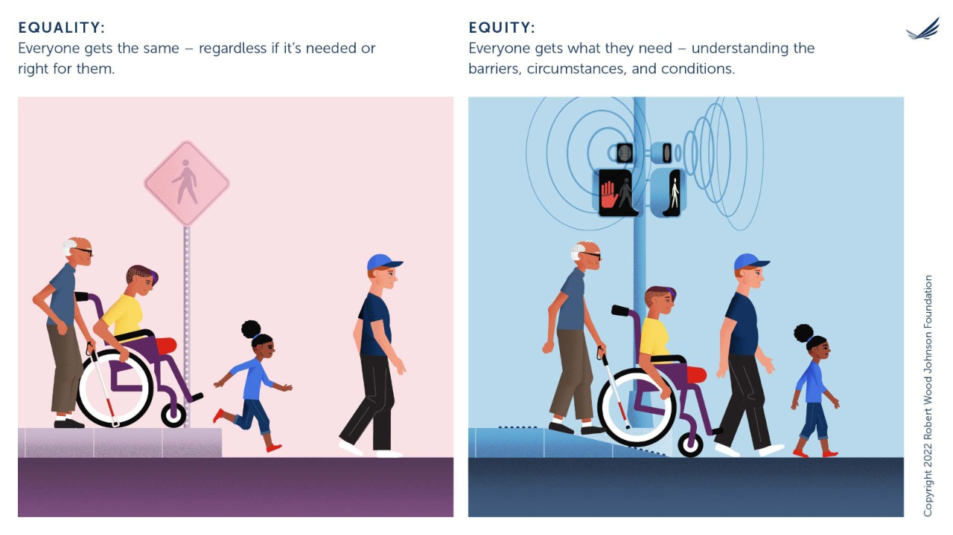
Who are these interested partners?
Diverse audiences
Race
Ethnicity
Gender
Age
Ability levels
Sexual orientation
Socioeconomic status
Living arrangement
Educational level
Professional background

Slide 14
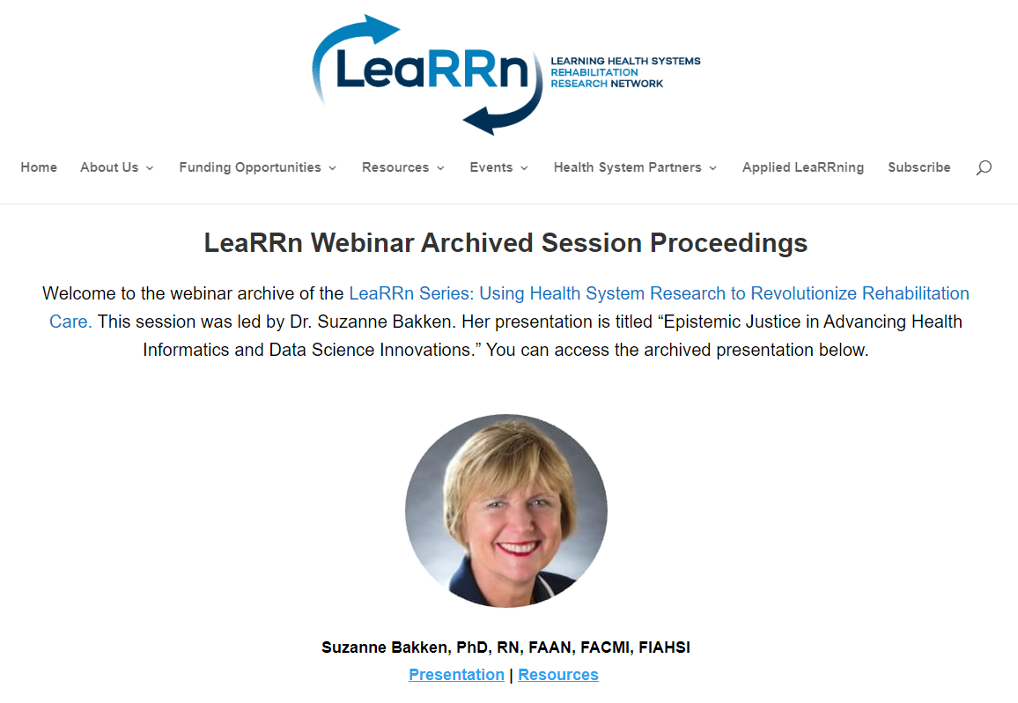

Slide 15
Experiences and beliefs about COVID-19 testing and vaccinations
N = 896 community members, 76 stakeholders, 13 community leaders
64% Latino, 25% Black, 7% Bangla, 4% Chinese

Slide 16
Bakken, S. (2024). Epistemic Justice in Advancing Health Informatics and Data Science Innovations. Retrieved from https://sites.brown.edu/learrn/home-2/edutrain/archived/archived-webinar-suzanne-bakken/

Slide 17
Recommendations when Designing for Dissemination
Engage interested partners early in the design process
Include partners to enhance the equitable messaging, packaging, and distribution of dissemination products
Pilot test products with intended audiences
Modify products according to pilot responses and reactions
Establish plans for measuring the impact of dissemination efforts
Update products to reflect evolving needs of interested partners
Bakken, S. (2024). Epistemic Justice in Advancing Health Informatics and Data Science Innovations. Retrieved from https://sites.brown.edu/learrn/home-2/edutrain/archived/archived-webinar-suzanne-bakken/

Slide 18
So how do we systematically develop dissemination strategies that align with the needs and interests of diverse audiences?
Diverse audiences
Race
Ethnicity
Gender
Age
Ability levels
Sexual orientation
Socioeconomic status
Living arrangement
Educational level
Professional background

Slide 19
Designing for dissemination
Conceptualization
Determine need and demand
Establish evidence base
Design
Design message, package, and distribution
Dissemination
Distribute products to intended audiences
Impact
Select outcomes to be measured
Measure outcomes
Adoption
Sustainment
Benefits to patients and families
Kwan, B. M., Brownson, R. C., Glasgow, R. E., Morrato, E. H., & Luke, D. A. (2022). Designing for Dissemination and Sustainability to Promote Equitable Impacts on Health. Annual Review of Public Health, 43, 331–353. https://doi.org/10.1146/annurev-publhealth-052220-112457

Slide 20
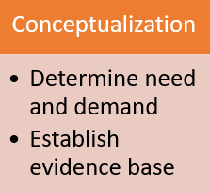
Conceptualization
Purpose:
Develop partnerships to address a priority health problem
Assess the context for which an innovative and equity-focused dissemination product will be used
How do we do this:
Literature reviews, focus groups, community and partner engagement, needs assessments, logic models
Brownson, R. C., Colditz, G. A., Proctor, E. K., and Chambers, D. F. (Eds.). (2023). Dissemination and Implementation Research in Health: Translating Science to Practice (Third Edition,). Oxford University Press.

Slide 21
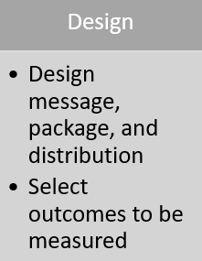
Design
Purpose:
Co-design products with partners that meet the needs and demands identified in the conceptualization phase
Create plans for active dissemination that align with the messaging, packaging, and distribution channels for intended audiences
How do we do this:
Information briefs, graphic design, infographics, interactive PDFs, websites, user-centered design and testing
Brownson, R. C., Colditz, G. A., Proctor, E. K., and Chambers, D. F. (Eds.). (2023). Dissemination and Implementation Research in Health: Translating Science to Practice (Third Edition,). Oxford University Press.

Slide 22
Dissemination
Purpose:
Enact plans – from design phase – to disseminate products
Build capacity for equitable adoption and sustainment with intended audiences
How do we do this:
Launch websites, email, social media, mass media campaigns, QR codes, endorsements from experts
Brownson, R. C., Colditz, G. A., Proctor, E. K., and Chambers, D. F. (Eds.). (2023). Dissemination and Implementation Research in Health: Translating Science to Practice (Third Edition,). Oxford University Press.

Slide 23
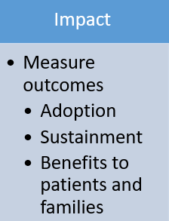
Impact
Purpose:
Demonstrate measurable impact of dissemination products to improve care quality
Adapt products iteratively to fit real-world context and the evolving needs of target audiences
How do we do this:
Website metrics (e.g., downloads, access counts), self-report measures, observational analyses, administrative data analysis, electronic health record data analysis
Brownson, R. C., Colditz, G. A., Proctor, E. K., and Chambers, D. F. (Eds.). (2023). Dissemination and Implementation Research in Health: Translating Science to Practice (Third Edition,). Oxford University Press.

Slide 24
Impact
Measurement tools:
Acceptability of Intervention Measure
Feasibility of Intervention Measure
Appropriateness of Intervention Measure
Evidence-Based Practice Attitudes Scale
Program Sustainability Tool
Society for Implementation Research Collaboration (2024). Instrument review project. Accessed from: https://societyforimplementationresearchcollaboration.org/sirc-instrument-project/

Slide 25
Designing for Dissemination: Stroke Rehab Case Example

Slide 26
Stroke
Leading cause of long-term disability
80% of stroke survivors have upper extremity impairments
Evidence-based assessment use is as low as 2.5%
Every 40 seconds, a U.S. adult has a stroke
Fugl-Meyer Assessment-UE: 5.0%
Action Research Arm Test: 2.5%
Notes:
SOME BACKGROUND
NUMBER OF STROKE SURVIVORS WILL RISE

Slide 27
Study purpose: To increase practitioners’ adoption of the Fugl-Meyer Assessment-UE and the Action Research Arm Test across the stroke care continuum
Design a package of dissemination strategies for OT practitioners
WHAT STRATEGIES?
American Occupational Therapy Foundation, Implementation Research Grant #AOTFIR21JUCKETT
Juckett, L. A., Wengerd, L. R., Banhos, M., & Darragh, A. R. (2022). Conducting Implementation Research in Stroke Rehabilitation: A Case Example and Considerations for Study Design. Neurorehabilitation and Neural Repair, 36(12), 770–776. https://doi.org/10.1177/15459683221138747

Slide 28
Designing for dissemination
Conceptualization
Determine need and demand
Establish evidence base
Design
Design message, package, and distribution
Dissemination
Distribute products to intended audiences
Impact
Select outcomes to be measured
Measure outcomes
Adoption
Sustainment
Benefits to patients and families
Kwan, B. M., Brownson, R. C., Glasgow, R. E., Morrato, E. H., & Luke, D. A. (2022). Designing for Dissemination and Sustainability to Promote Equitable Impacts on Health. Annual Review of Public Health, 43, 331–353. https://doi.org/10.1146/annurev-publhealth-052220-112457

Slide 29
Conceptualization
What we did:
Partnered with rehab leaders from acute care, inpatient rehabilitation, and outpatient rehabilitation at Ohio State’s Medical Center
Conducted a scoping review to identify common barriers to outcome measure use in stroke rehab
Knowledge, resources, beliefs, benefits, documentation
Held listening sessions with key informants and rehab leaders to understand context
Characteristics of practitioners, resources available, preferred ways of learning information
Juckett, L. A., Wengerd, L. R., Faieta, J., & Griffin, C. E. (2020). Evidence-Based Practice Implementation in Stroke Rehabilitation: A Scoping Review of Barriers and Facilitators. The American Journal of Occupational Therapy, 74(1), 7401205050p1-7401205050p14. https://doi.org/10.5014/ajot.2020.035485

Slide 30
Design
What we did:
Identified methods for measuring adoption
Electronic health record data
Designed dissemination AND implementation strategies in response to needs identified in conceptualization phase
Created educational materials
Appointed champions
Conducted training sessions
Provided necessary equipment*
Changed documentation fields in EHR system*

Slide 31
Dissemination
What we did:
Created educational materials
Print instruction manuals
E-manuals accessible by QR code
Laminated score cards in rehab gyms
Appointed champions
Advanced training in outcome measures
Technical assistance to peers
Conducted training sessions
In-person session
Web-based videos with stroke survivors

Slide 32
Created educational materials: Dec 2021 – April 2022
Fugl-Meyer Assessment instruction manual
Fugl-Meyer Assessment demonstration video
Notes:
Actual e-manuals; not ready for dissemination

Slide 33
Appointed champions: Aug 2021 – Dec 2021
Acute care
Inpatient
Outpatient
Notes:
Two champions at each site

Slide 34
Conducted training sessions: Mar 2022 – Apr 2022
Acute care (n = 8)
Inpatient (n = 10)
Outpatient (n = 8)

Slide 35
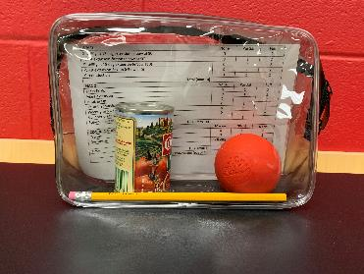
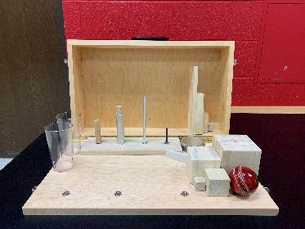
Provided equipment: Mar – Apr 2022*
Acute care: Individual Fugl-Meyer kits
Inpatient: Three Fugl-Meyer kits; one ARAT kit
Outpatient: Individual Fugl-Meyer kits; one ARAT kit (three sites)

Slide 36
Changed documentation fields: Aug 2021 – Sept 2022*
Notes:
EPIC reformatting

Slide 37
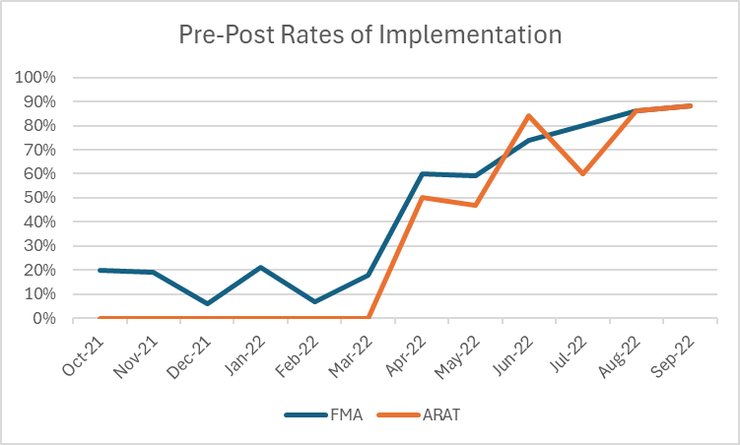
Impact
Preliminary findings:
Adoption: Pre/post chart audits

Slide 38
Designing for dissemination
Conceptualization
Selected FMA and ARAT
Found barriers related to knowledge, resources, beliefs, benefits, documentation
Design
Metric: adoption
Dissemination
In-person training
Impact
Significant increase in FMA and ARAT use after deployment of dissemination strategies
Created educational materials
Appointed champions
Conducted training sessions
QR codes
Web-based videos
Printed materials
Trusted peers
Necessary equipment
Kwan, B. M., Brownson, R. C., Glasgow, R. E., Morrato, E. H., & Luke, D. A. (2022). Designing for Dissemination and Sustainability to Promote Equitable Impacts on Health. Annual Review of Public Health, 43, 331–353. https://doi.org/10.1146/annurev-publhealth-052220-112457

Slide 39
Designing for Dissemination Recommendations
Engage interested partners early in dissemination product design
Establish a plan for measuring the impact of your products
Pilot test product options with intended audiences
Refine products according to audience responses and reactions
Involve partners in the equitable messaging, packaging, and distributing of dissemination products
Iteratively modify products to meet the evolving needs of your target context and audience

Slide 40
THANK YOU!

