Slide 1
Why PTPAC is Important for the Physical Therapy Profession
APTA Flash Action Strategy 2024
Notes:
Advocacy is critical to advancing and protecting the physical therapy profession. APTA works with Congress on issues important to the profession. As a constituent, your voice is powerful with your elected officials. APTA members must raise their voices with Congress; your perspective in the physical therapy profession is important in raising awareness and support for these issues.
PTPAC is the political action committee of APTA and is the sole fundraising organization that provides access to and influence on legislators to champion physical therapy legislative interests at the federal level. PTPAC relies on voluntary donations from APTA members, not member dues, to have our voice heard in Congress. By attending fundraisers both in Washington DC, and across the country, APTA staff and members have important facetime with legislators to discuss issues important to the profession.
Our work has earned PTPAC recognition as one of the top 10 health professional association PACs and PTPAC has disbursed almost $1.1 million in direct contributions to federal candidates, leadership PACs, and national political party committees in the last election cycle. The impact to the physical therapy profession through the influence of PTPAC, is a direct result of those who support our advocacy efforts through a commitment to PTPAC.
What is a political action committee?

Slide 2
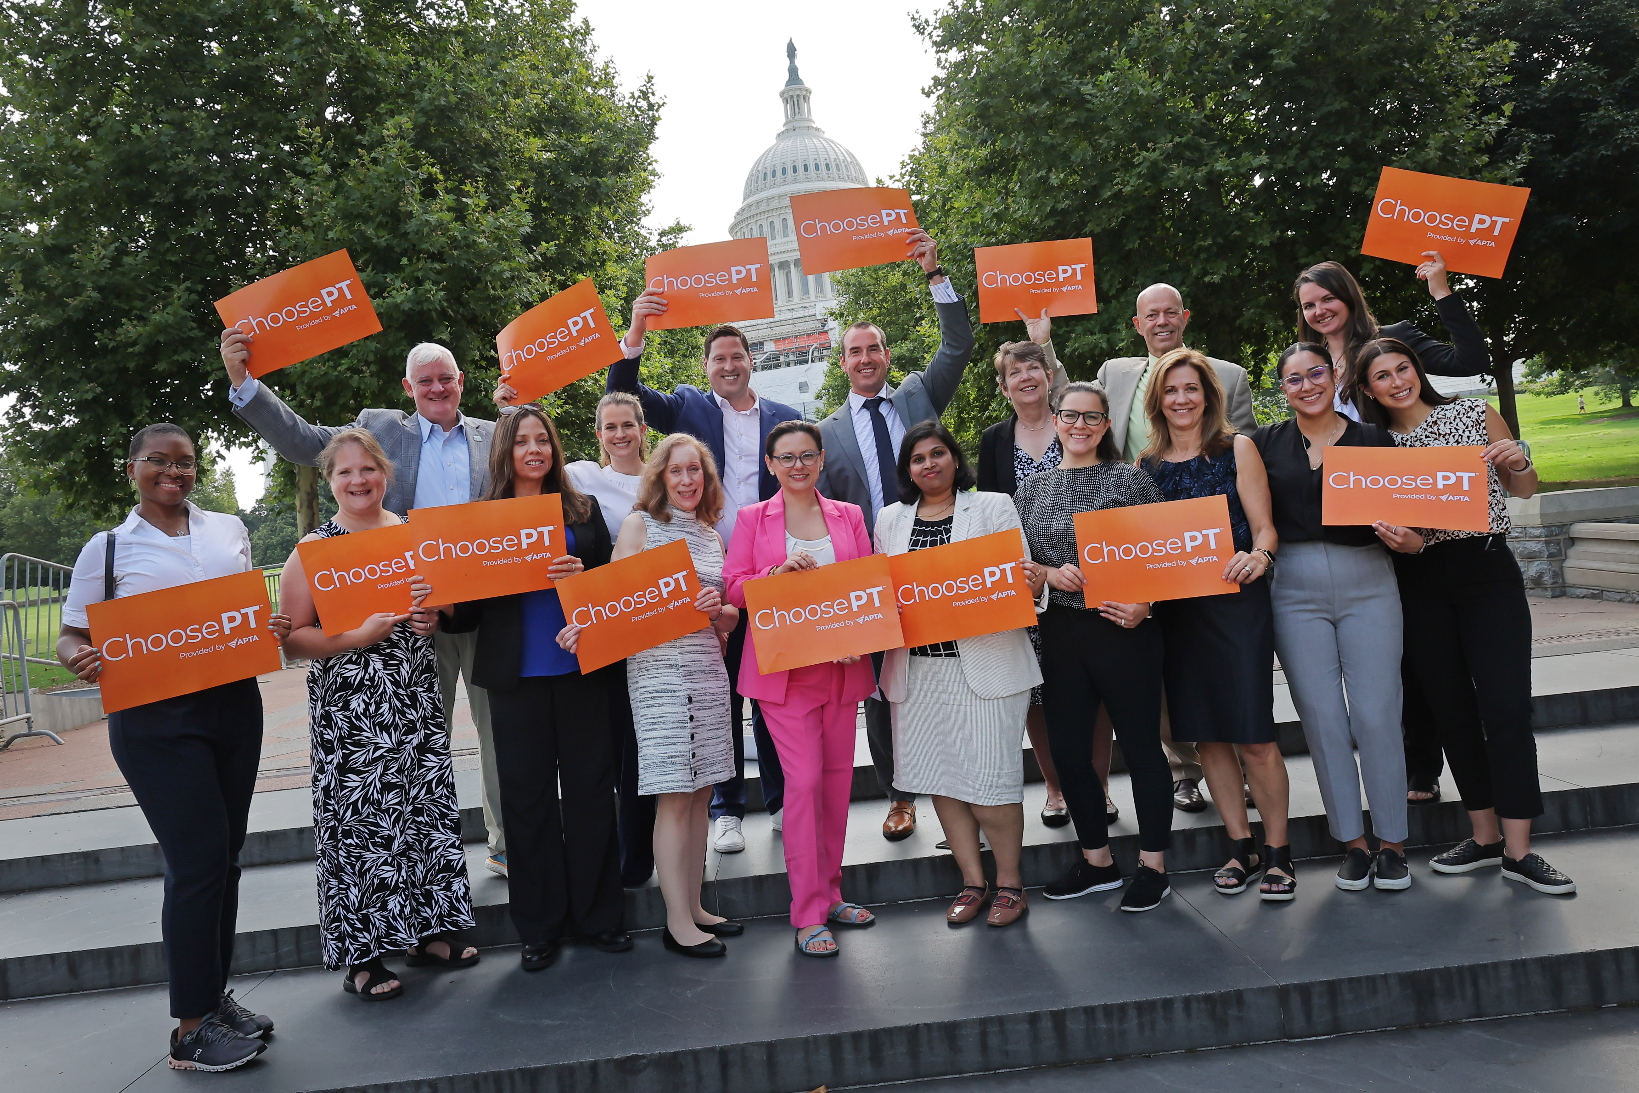
What is a Federal Political Action Committee?
Separate fund connected to a company, association, or labor union
PTPAC can only solicit donations from members of APTA
PTPAC cannot use APTA dues; it is illegal
Notes:
A political action committee is a separate fund connected to a company, association, or labor union. By federal law, this fund must be separate and can only be used for political donations. Because the fund is connected to the association, only members of the association may be solicited for donations. PACs are the most regulated and transparent form of campaign finance. APTA must follow and be in compliance with all campaign finance laws as political action committees are strictly regulated by the Federal Election Commission.
By federal law, APTA dues cannot go to PTPAC for campaign donations for those running for Congress. PTPAC must raise funds on our own. Every person and every dollar donation strengthens the impact we have on Capitol Hill for our profession and our patients.

Slide 3
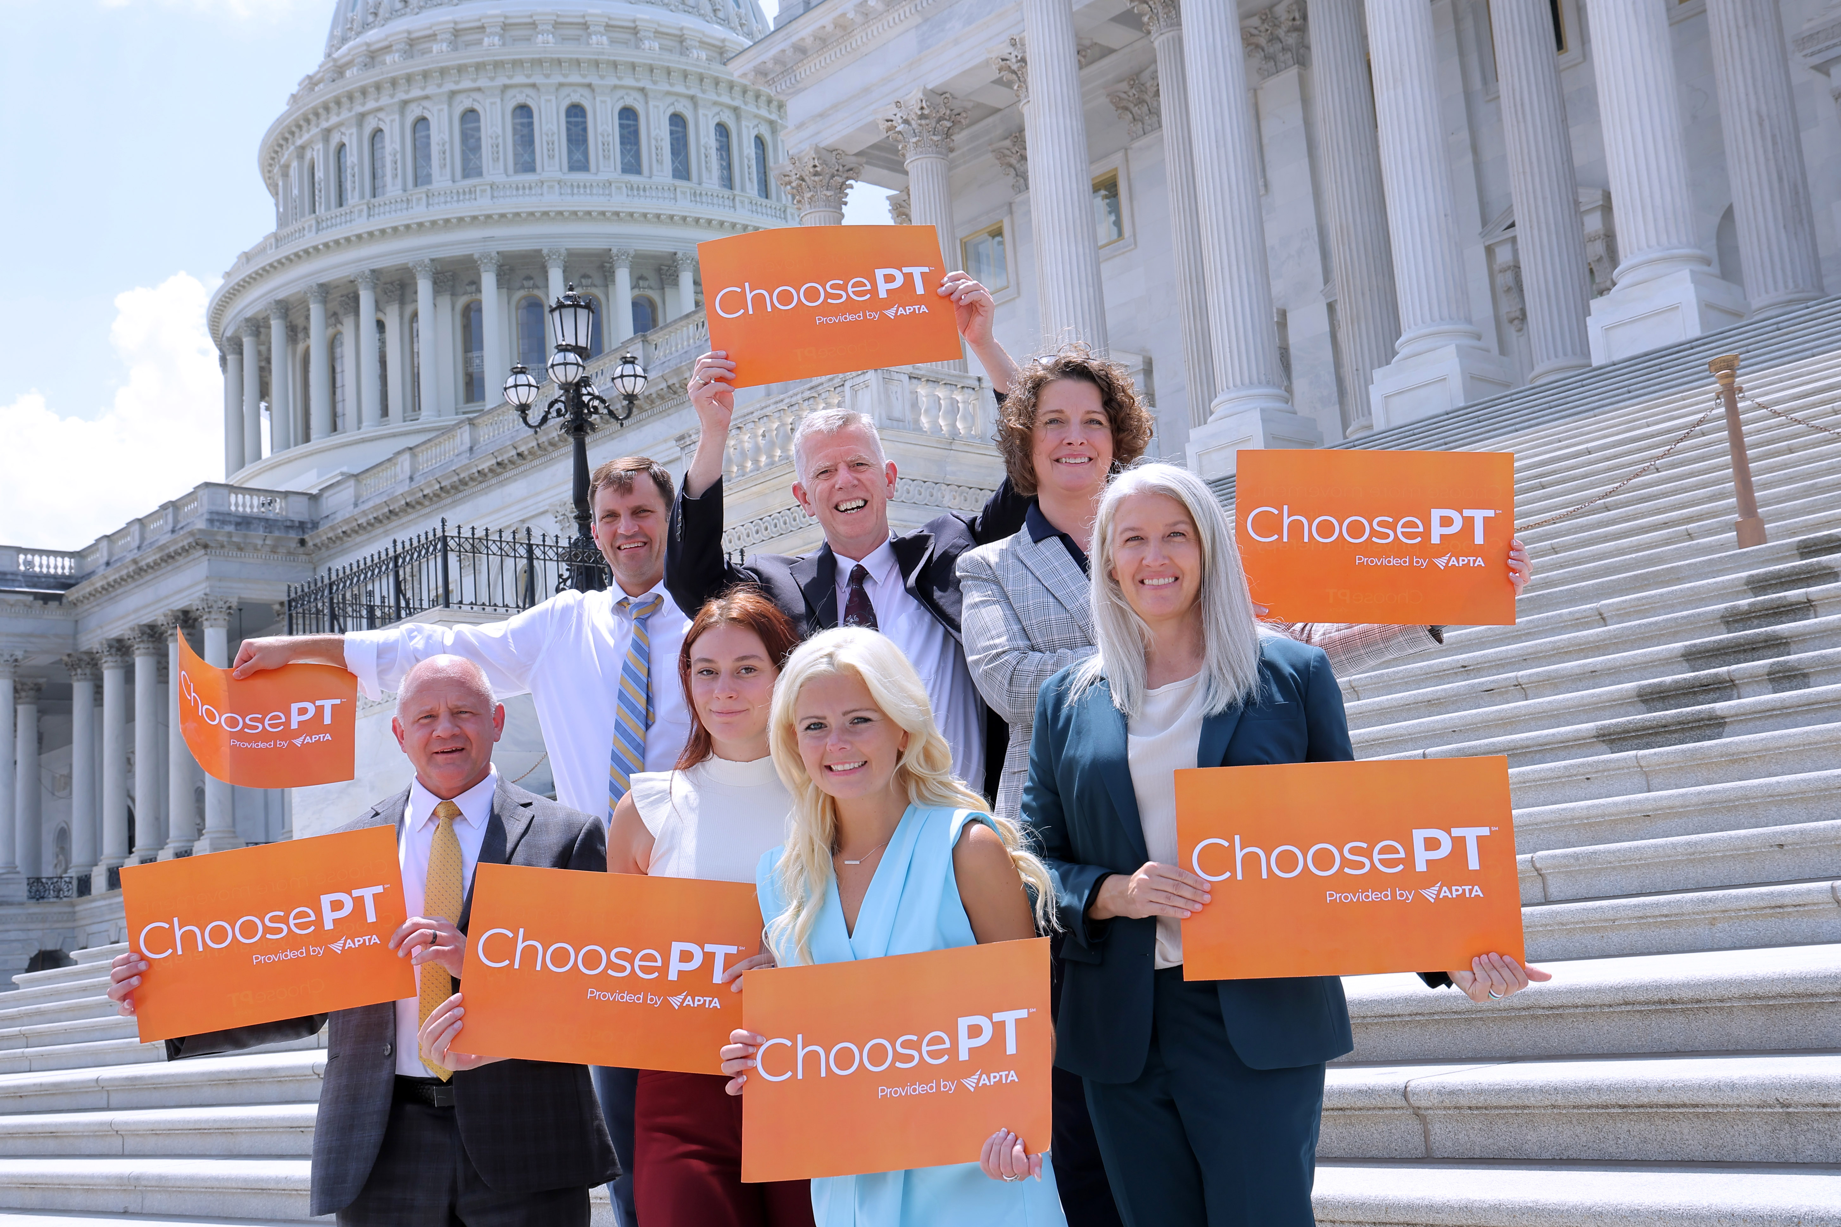
What is a Federal Political Action Committee?
An APTA member can give up to $5,000 a year to PTPAC
PTPAC can give $5,000 to congressional candidates running in a primary and $5,000 to candidates running in the general election
PTPAC must follow campaign finance laws
Notes:
Every donation to PTPAC is important and helps us further our influence on Capitol Hill. By campaign finance law, APTA members can give up to $5,000 a year to PTPAC.
PTPAC can give $5,000 to congressional candidates running in a primary. Primaries are elections where a political party selects a candidate for an upcoming general election. For a general election, like the one coming up in November, APTA can give up to $5,000 to candidates.
Why should you care about PTPAC as a student?

Slide 4
Why Should I Care About PTPAC?
PTPAC is bipartisan
PTPAC supports candidates that are supportive of physical therapy
Other health care provider associations have a PAC
Legislators must hear our voice representing the physical therapy profession instead of another health care provider
If you’re not at the table, you’re on the menu!
Notes:
PTPAC supports PT friendly members of Congress and candidates in their election campaigns. PTPAC is bipartisan and we must work with all political parties to advance legislation. The distribution of funds to the political parties is 50/50. As you donate to PTPAC and feel strongly about what party you want your funds to go toward, you may select your chosen party as you make your donation.
Nearly every health care association has a political action committee. If PTPAC did not exist, those other political action committees would be speaking on behalf of the physical therapy profession. Out of the 2,875 PACs registered with the FEC, 42% are association PACs. In order for our voice to be heard, the physical therapy profession must have a seat at the table. If you’re not at the table, you’re on the menu.
What does PTPAC do to further legislation?

Slide 5
Why Should I Care About PTPAC?
PTPAC provides access
Gives APTA members and lobbyists at seat at the table at fundraisers in Washington, DC and at home.
Find an opportunity to attend a fundraiser? Contact ptpac@apta.org
Opportunity to talk to legislators about issues that concern the profession directly
Members of Congress have busy schedules and often a fundraiser is the only time to see them in person
Builds relationships with members of Congress and their staff
Notes:
PTPAC provides direct access to members of Congress. Through sending APTA lobbyists and advocates to fundraisers, PTPAC provides opportunities to talk directly to members of Congress at fundraisers about the issues of concern to the profession and builds relationships with members of Congress and their staff. Without a robust PAC, we lose out on critical opportunities for influence.
If you see an opportunity to attend a fundraiser in your area, please reach out to ptpac@apta.org for funding consideration. You can find fundraiser opportunities by following the campaign social media handles for your members of Congress and for signing up for their campaign emails. Members of Congress have two different websites and social media handles for FEC legal reasons; one is for their official capacity as a sworn government official and the other is for their campaign.
PTPAC has an immense influence in a critical election year and that’s why this year’s Flash Action Strategy is focusing on it.
How can you participate in Flash Action Strategy?

Slide 6
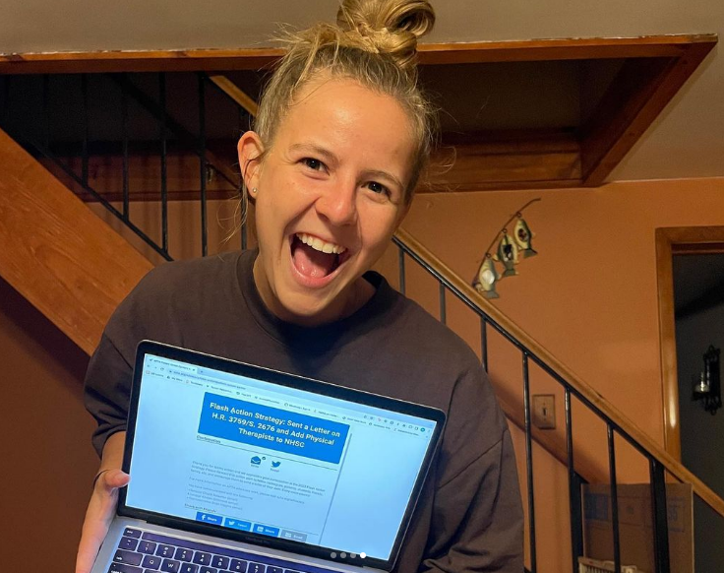
How to Participate in Flash Action Strategy
Donate any amount to PTPAC
Donate $20 to PTPAC and become a Student Star
Post about PTPAC on social media
Raise awareness of PTPAC
Follow @aptastudents @aptapics and @aptatweets
Notes:
To participate in Flash Action Strategy September 25-26 you can:
Find a time before or after class to encourage everyone to post at the same time
Donate whatever you can to PTPAC; if you donate $20, you are eligible to become a Student Star.
Post one of the graphics from the Flash Action Strategy webpage and why you support PTPAC. Be sure to use #FAS2024 and #PTAdvocacy. Pre-made graphics will be available for your use.
Follow @aptastudents @aptapics and @aptatweets for more information and to join in the conversation.
What other advocacy activities are available for students and your future career to raise your voice with legislators?

Slide 7
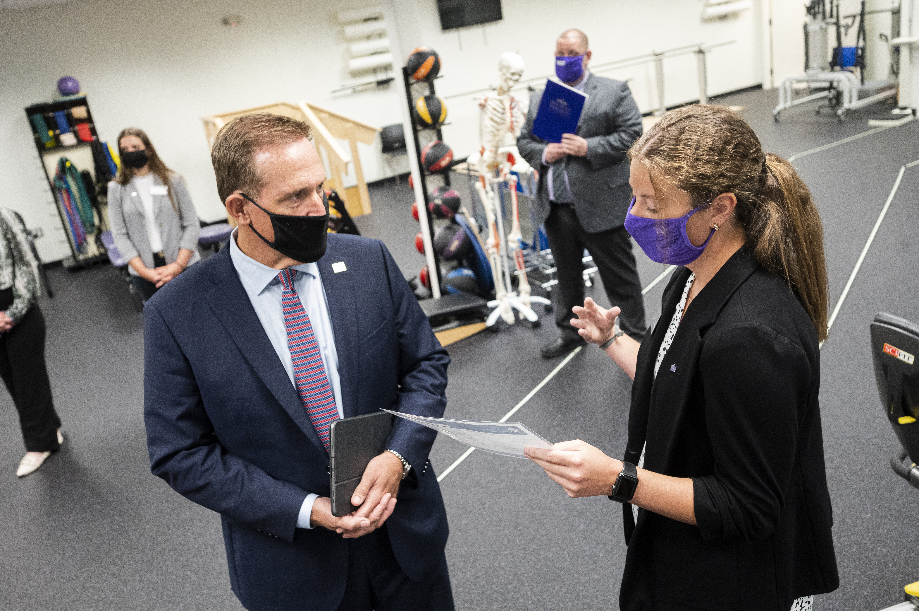
More Student Involvement and Beyond
Student Advocacy Challenge
APTA Advocacy Network
Notes:
APTA has programs and resources for student involvement throughout the year and throughout your career.
Encourage your program to participate in the Student Advocacy Challenge
The Student Advocacy Challenge is a competition among PT and PTA programs to participate in advocacy activities for points.
On the Student Advocacy Challenge webpage, there is a menu of activities that you can complete for points. You can submit your activities for credit through the APTA website or APTA Advocacy App. Participating in Flash Action Strategy is eligible for 10 points and there is no limit on the number of points. Posting on social media about Flash Action Strategy and donating to PTPAC counts as participation in Flash Action Strategy. If you donate $20, you can submit it for both participation in Flash Action Strategy and for a Student Star, giving your program even more points!
The Challenge runs from January 2024-end of December 2024. The winning program will not only get bragging rights, but featured on APTA’s website and will receive a virtual or in-person presentation by an APTA staff or Board member of the program’s choice.
Join APTA’s advocacy strength in numbers by signing up for the APTA Advocacy Network.
Network members receive periodic action alerts, which asks for support on an issue by sending a letter to your members of Congress.
By sending thousands of letters to Capitol Hill on a particular topic, this shows support and helps to educate and inform lawmakers.
It takes minimal time to be a part of the APTA Advocacy Network but makes a huge impact; to send a letter to Congress takes about 3 minutes. APTA Advocacy Network members also receive Information Bulletins, which are breaking news updates, and a bi-monthly newsletter.
Get active in advocacy now as a student and stay active throughout your career. Advocacy is a marathon, not a sprint.
You are a vital part of APTA’s advocacy program because you’re the constituent and you’re the expert! Your unique experience in the physical therapy profession is important and members of Congress want and need to hear from you. When we’re all advocating together, we can make a difference in the physical therapy profession and the patients we serve.

Slide 8
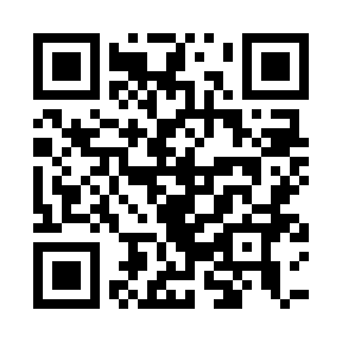
Let Your Voice Be Heard in Congress - What’s at Stake for our Practices and Patients?
Medicare payment reform, PTA supervision, telehealth, prior authorization, eliminating barriers to our services
PTPAC, the political action committee of APTA, provides access to federal legislators and builds champions on Capitol Hill for physical therapy issues.
Please donate to PTPAC and help our efforts in Congress and on Election Day.
Personal Donations Only

Slide 9
Thank You for Participating
advocacy@apta.org
Notes:
Thank you for your participation in APTA Flash Action Strategy. We look forward to seeing thousands of students raising their voice on social media September 25-26. You are the future of the physical therapy profession and your involvement in advocacy is critical to advance the profession.
For more advocacy resources, and to learn more about our advocacy programs, check out and share the below links:
Student Advocacy Challenge: https://www.apta.org/apta-and-you/online-forms/student-advocacy-challenge
APTA Advocacy Network: https://www.apta.org/advocacy/apta-advocacy-network

