Slide 1
Participating in Flash Action Strategy 2023
September 20-21, 2023

Slide 2



What is Flash Action Strategy?
Driven by students, it’s two days where both students and schools take to social media and email to educate members of Congress about a legislative priority that impacts the physical therapy profession.
Educating students on an issue that impacts the profession.
Graphics are from past Flash Action Strategies

Slide 3
What Are We Advocating For?
Optimizing Postpartum Outcomes Act (H.R. 2480)
  Raise awareness of the availability and importance of pelvic health services for postpartum women.
  Pelvic health PT is vital for preserving maternal health
Many women lack access and awareness of the benefits of pelvic health physical therapy
  This can lead to lasting problems with mobility, incontinence, sexual disfunction and numerous other issues
H.R. 2480 will directly address this information gap
  Issue guidance for Medicaid and CHIP during the postpartum period
  Instruct GAO to conduct a study on pelvic health programs

Slide 4
Our Goal
Add more cosponsors to the Optimizing Postpartum Outcomes Act (H.R. 2480)
  The more cosponsors a bill has, the higher chance of it going to the floor for a vote.
  Check out congress.gov and search for the bill numbers, or the APTA Advocacy App for bill cosponsor updates as they change frequently.
  How do we help accomplish this? Let’s send 5,000 letters to Congress during the two days of Flash Action Strategy.

Slide 5
How to Participate: Way #1
Interact on social media
  Tell legislators how the legislation would affect you/people you know
  Tell your legislators what it’s like to be a PT/PTA student – education about physical therapy is important!
  Tag your posts #PTAdvocacy and #FAS2023 to join in the conversation
  Sample posts will be available on the Flash Action Strategy website
  Follow @APTApics and @APTAtweets for graphics and other ways to spread the message

Slide 6
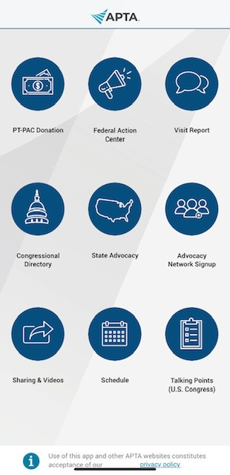
How to Participate: Way #2
APTA Advocacy App
  Available in the App Store for Apple or Google Play for Android
  Search “APTA Advocacy”
  Not only can you participate in FAS by using the app, you can:
    Contact your members of Congress through the Federal Action Center button
    Participate in the Student Advocacy Challenge by tapping on “Visit Report” and logging your activities
    Join the APTA Advocacy Network and receive advocacy news and ways to take action
    Become a Student Star by giving $20 to PTPAC
    Check out talking points on priority issues
    See what bills your members of Congress do (or don’t!) support

Slide 7
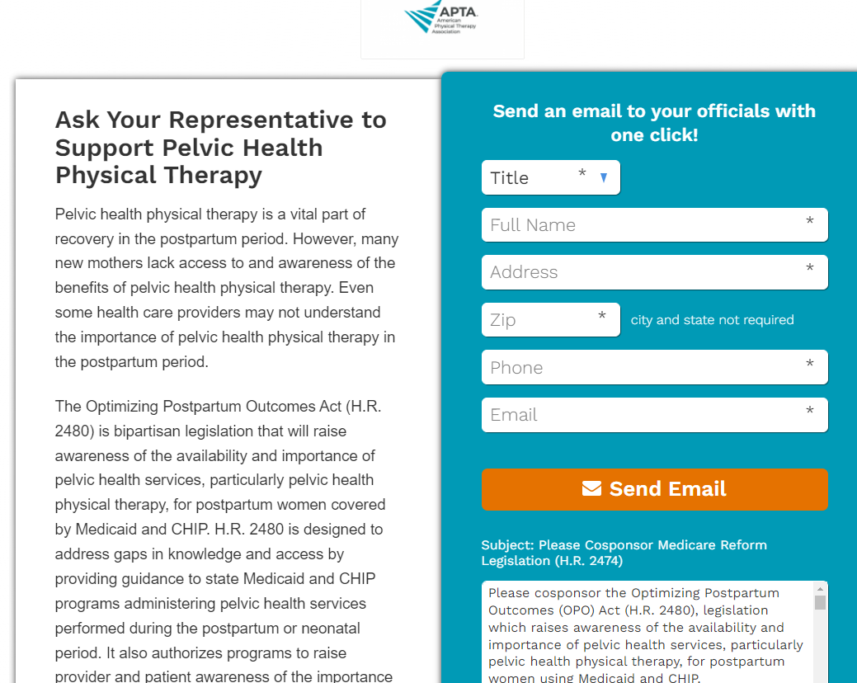
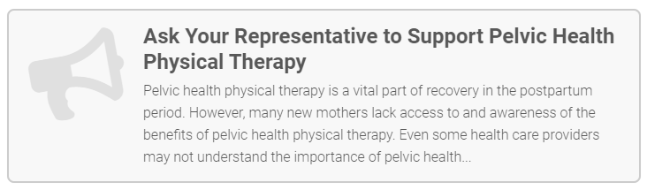
How to Participate: Way #3
Send letters to Congress
  Visit the Legislative Action Center for APTA members
  Visit the Patient Action Center for non-APTA members and shareable on social media
  Goal is to send 5,000 letters during Flash Action Strategy
  apta.org/advocacy/take-action
Legislative Action Center Example
Patient Action Center Example

Slide 8
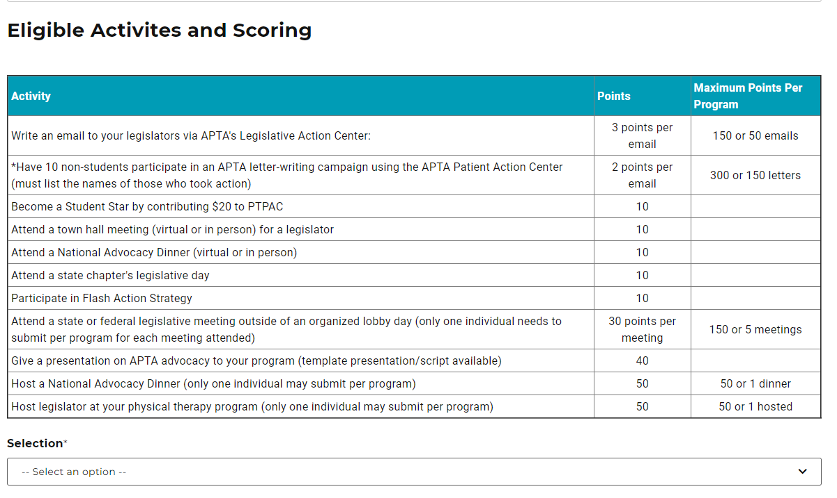
How to Participate: Way #4
Let us know you participated by submitting your activity for credit in the Student Advocacy Challenge.
Find the form at https://www.apta.org/apta-and-you/online-forms/student-advocacy-challenge

Slide 9
Flash Action Strategy Do’s and Don’ts
DO
DON’T
Encourage your fellow students to participate. We need strength in numbers!
Stay on message. We are more powerful when we are all asking for the same thing.
Post pictures. Educate legislators on what life is like for a PT/PTA student.
Include bill numbers
Refer to members of Congress with their proper titles and remember the difference between the House and Senate.
Tag your posts with legislators who are not your own. Go to house.gov or senate.gov to find out who your legislators are.
Go negative or be partisan. APTA is bipartisan and we expect members, including students, to behave in a respectful way, even if you disagree
Forget to tag your legislators and use #PTAdvocacy and #FAS2023
Engage trolls
Post more than 10 times in one day

Slide 10
Your Impact
Members of Congress don’t know how they can help unless we educate them. You can be the one who educates members of Congress about physical therapy and the positive impact it has on patients and your community
Advocacy is important throughout your career. Get started by participating in APTA student advocacy programs:
  Student Advocacy Challenge (all year)
  National Advocacy Dinner (spring)
  Flash Action Strategy (fall)

Slide 11
Thank you
You make a difference!
Questions?
Laura Keivel
laurakeivel@apta.org

